Slide 1

Final Project Presentation
Readmission Of Patients

Slide 2
Use case of the project
For the course project, we will be investigating the problem of predicting readmission of hospital patients. Readmission of patients following discharge from hospital places an enormous and very expensive burden on the US healthcare system (estimated at $40B in 2011).
The objective of this project is to predict the early (<30 days) readmission given the patient’s features. We are trying to predict if a patient gets admitted before 30 days or not , so that the allocation can be better managed.

Slide 3
The DAtaset
We will use this UCI dataset. The dataset represents 10 years (1999-2008) of clinical care at 130 US hospitals and integrated delivery networks. It includes over 50 features representing patient and hospital outcomes. Information was extracted from the database for encounters that satisfied the following criteria.
It is an inpatient encounter (a hospital admission).
It is a diabetic encounter, that is, one during which any kind of diabetes was entered into the system as a diagnosis.
The length of stay was at least 1 day and at most 14 days.
Laboratory tests were performed during the encounter.
Medications were administered during the encounter.
The data contains such attributes as patient number, race, gender, age, admission type, time in hospital, medical specialty of admitting physician, number of lab test performed, HbA1c test result, diagnosis, number of medications, diabetic medications, number of outpatient, inpatient, and emergency visits in the year before the hospitalization, etc.

Slide 4

Exploring the data
Basic Data Information:
The Train Dataset contains 76324 rows while the Test Dataset contains 25442 rows.
Number of Feature columns: 50
Number of Target column = 1
Number of numeric columns: 13
Number of categorical columns: 37
Target Column:
We converted the target column from multivariate to Bivariate by grouping category ’No’ and category ’>30’ together as “other” and ’<30’ was considered as a seperate category.
The number of readmitted cases before 30 days were 11357 whereas the number of not admitted or readmitted after 30 days were 90409.

Slide 5
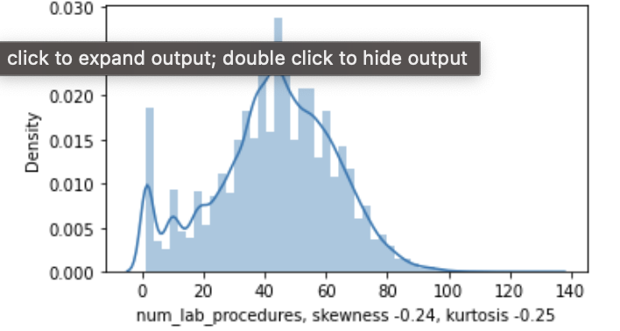
Univariate analysis of Numeric columns
We performed Univariate analysis on Categorical as well as numeric columns. Here are some of the insights:
1. num_lab procedures distribution is fairly symmetrical.

Slide 6
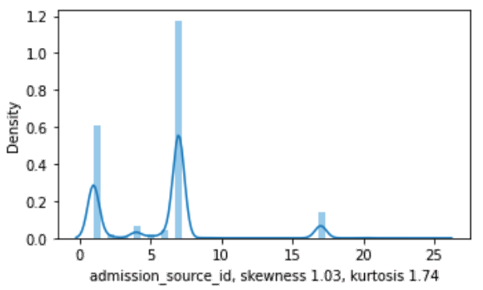
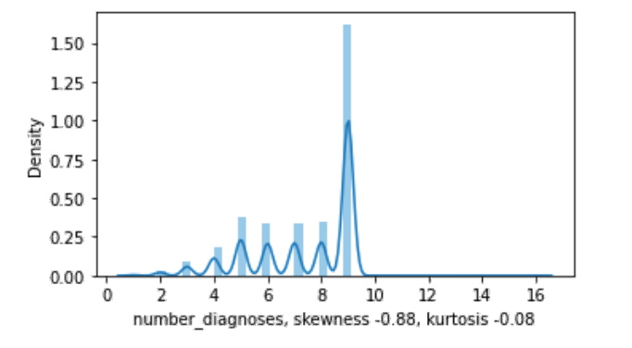
admission_source_id, number_diagnosis columns are moderaltely skewed.
Univariate analysis

Slide 7
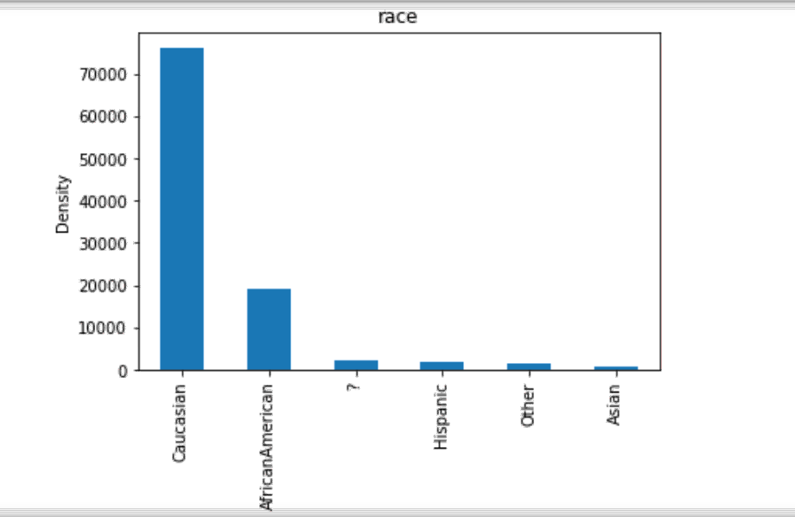
Race columns has 5 races and also some null values represented by ?, The data has most entries of people who are originated from caucasian or are African American.

Slide 8
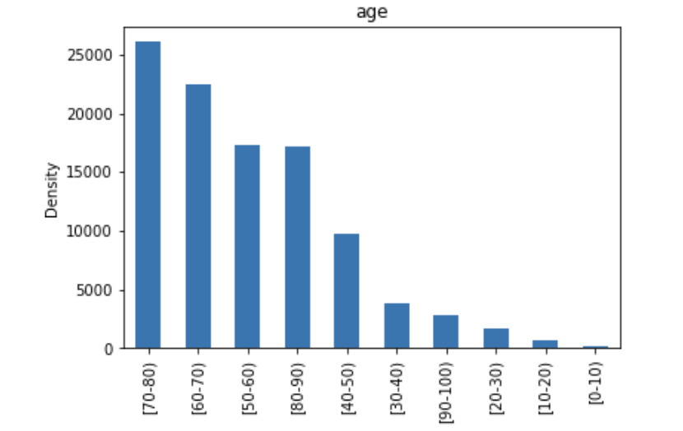
Age 50-70 as expected has more enteries as they have more chances to get admitted in a hospital.

Slide 9
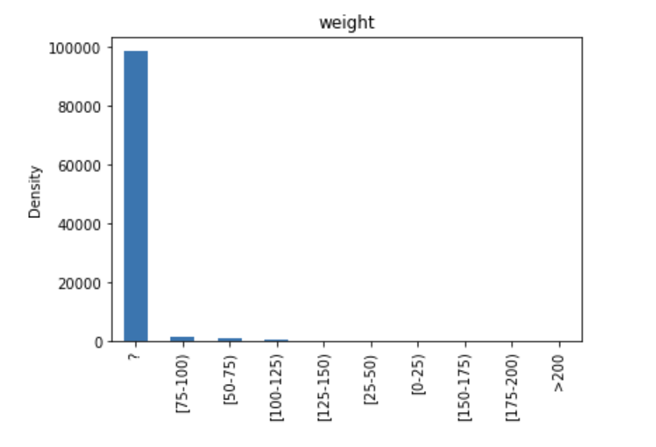
97% values in weight are missing so it will be good to drop this column.

Slide 10
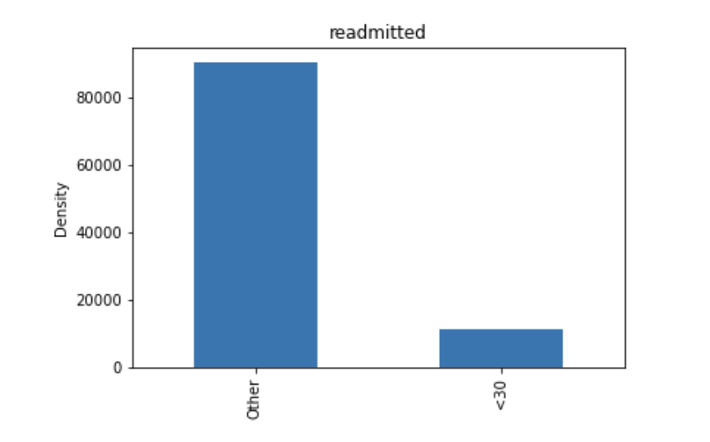
Target column is highly imbalanced.

Slide 11
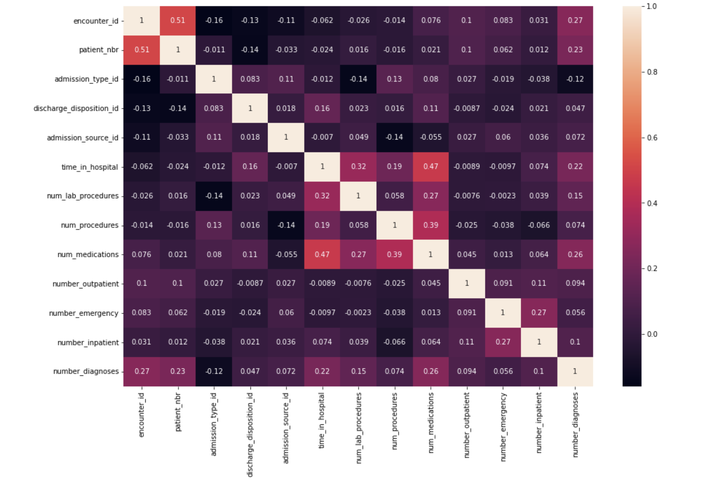
Bivariate analysis
Insights from above heamap:
encounter_id and patient_nbr have high positive correlation
time_in_hospital and num_medication also have high positive correlation
time_in_hospital, num_lab_procedures, num_procedures and num_medication also have good positive correlation

Slide 12
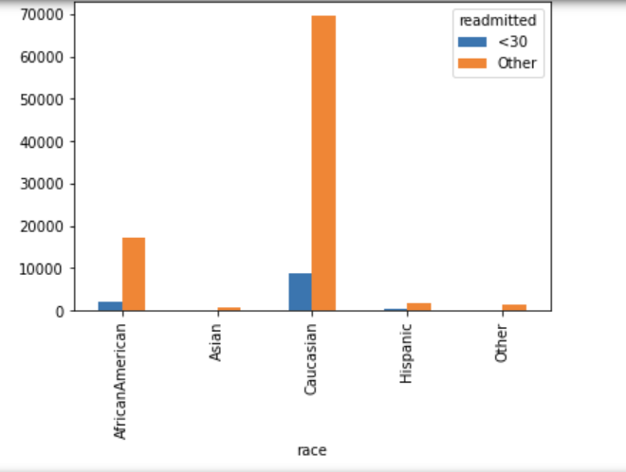
target column VS categorical columns
Race which belongs to Caucasian and African American have more chances of readmitted within 30 days

Slide 13
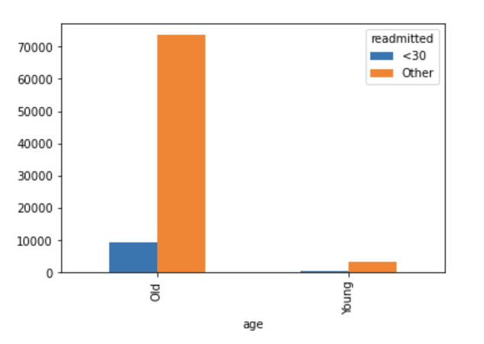
Age 50-90 have more chances of readmitting within 30 days.
target column VS categorical columns

Slide 14

sanitizing the data
Columns Dropped:
Weight column had 97% missing values so dropping that column
Dropping examide and citoglipton since they had only one category in them.
Dropped columns based on low variance.
Dropped encounter_id and patient_nbr because they are just all unique IDs.
Dropping medical_speciality as its contain lots of categories in it.

Slide 15
Data Imputation
Imputed Null (?) of following columns with mode:
race
payer_code
medical_specialty
diag3

Slide 16
Data Binning
Binned Diag1, Diag2 , Diag3 as given in ICD-9 code:
001–139: infectious and parasitic diseases
140–239: neoplasms
240–279: endocrine, nutritional and metabolic diseases, and immunity disorders
280–289: diseases of the blood and blood-forming organs
290–319: mental disorders
320–389: diseases of the nervous system and sense organs
390–459: diseases of the circulatory system
460–519: diseases of the respiratory system
520–579: diseases of the digestive system
580–629: diseases of the genitourinary system
630–679: complications of pregnancy, childbirth, and the puerperium
680–709: diseases of the skin and subcutaneous tissue
710–739: diseases of the musculoskeletal system and connective tissue
740–759: congenital anomalies
780–799: symptoms, signs, and ill-defined conditions
800–999: injury and poisoning
760–779: certain conditions originating in the perinatal period
E and V codes: external causes of injury and supplemental classification

Slide 17
Binning age
Binning age into young, middle-age and old
age greater than or equal to 20: Young
age greater 20 and smaller than or equal to 50: Middle Age
age greater than 50: Old

Slide 18
Preprocessing the data
Encoded Categorical columns
Example:
Race column before encoding:
[Screenshot]
Race column after encoding
[screenshot]
Scaled the data using standard scaler.
Explanation of standard scaler
Standardize features by removing the mean and scaling to unit variance.The standard score of a sample x is calculated as z = (x - u) / s. where u is the mean of the training samples or zero if with_mean=False, and s is the standard deviation of the training samples or one if with_std=False.
Data before scaling
[]screenshot]
Data after scaling
[screenshot]
Encoding target column
Other class was converted to zero and <30 was converted to 1
Before and after screenshots

Slide 19
Feature selection
Performed PCA with different variation of resulting number of features
Before and after data shape and some explanation of how you did it.
Write like we used PCA from sklearn
Some information about the method from sklearn: Linear dimensionality reduction using Singular Value Decomposition of the data to project it to a lower dimensional space. The input data is centered but not scaled for each feature before applying the SVD.

Slide 20

Model Training and Evaluation
Tried the following classification models:
Logistic Regression
Random Forest
Decision Tree Classifier
Adaboost Classifier
XGBoost

Slide 21
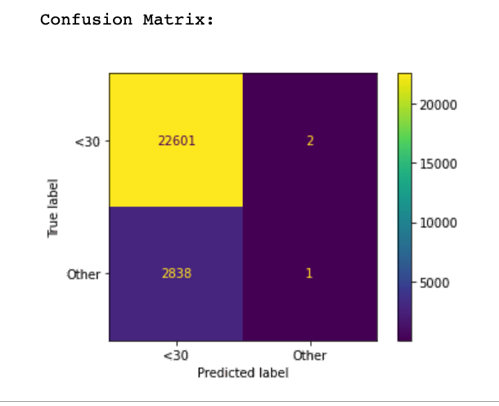
Logistic Regression
Accuracy: 88.84% .

Slide 22
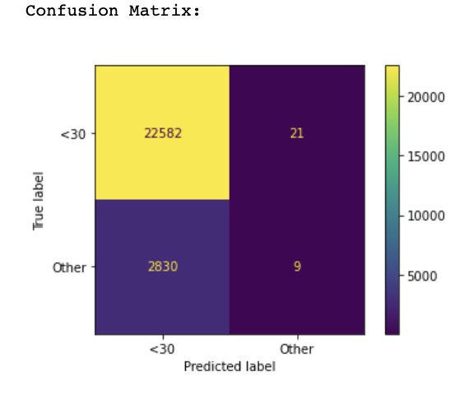
Random Forest
Accuracy: 88.79%

Slide 23
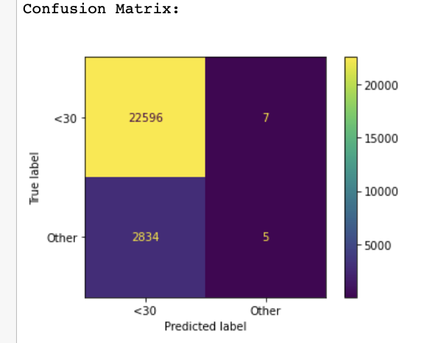
Decision Tree Classifier
Accuracy of Decision Tree Model: 88.83%

Slide 24

AdaBoost Classifier
Accuracy of Adaboost Model: 88.84%

Slide 25
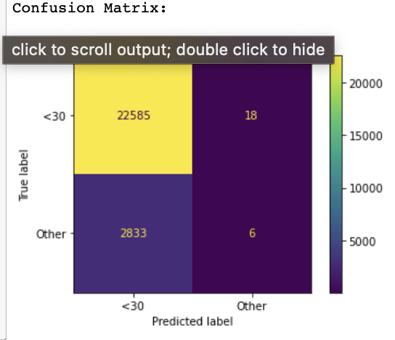
XGBoost
Accuracy of XGBoost Model: 88.79%

Slide 26
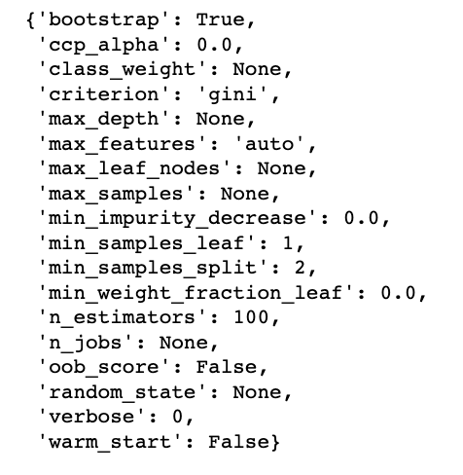
Hyper-Parameter Tuning
Performed hyperparameter tuning over Random Forest.
Parameters used by Random Forest in default setting are :

Slide 27
USed RandomizedSeachCV from Sklearn to search for best hyperparameters.
Following hyperparameter grid was used:
{'n_estimators': [100, 150, 200],
'max_features': ['auto', 'sqrt'],
'max_depth': [10, 20, 30, 40, None],
'min_samples_split': [2, 5, 10],
'min_samples_leaf': [1, 2, 4],
'bootstrap': [True, False]}

Slide 28
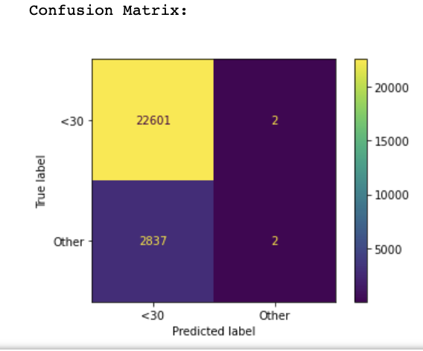
Performed Random search of parameters, using K fold cross validation
Predicted with the best fit model.
Results:
Accuracy of resulting Random Forest Model: 88.84%

